Slide 1
Strategic Marketing Simulator 1.0 Sprint 7 review
Strategic Marketing Simulator 1.0
Team # 15
Team Members
Javier Andrial
Jeffrey Carman
Product Owner: Joseph Cilli
Project Mentor: Masoud Sadjadi

Slide 2
User Story 1
#842 Professor Feedback
Description:
This page will display their end of period comments as well as any feedback the professor has provided
Acceptance Criteria:
user is a student
user is registered to a Game
Tasks
T

Slide 3
Goals
#842 Professor Feedback
The goal of this page

Slide 4
Functional Requirements 1
#853 Student Reporting Page
Function requirements
User
Non function requirements
Dis

Slide 5
Scenarios
853 Student Reporting Page
Scenarios 36 – Student views feedback
Student Phil, is interested if his professor has provided feedback for his end of period comment last period. Phil, navigates to the reporting page via the toolbar. Phil, sees his comment from last period and is able to see that the professor did provide feedback and it was very positive.

Slide 6
Use Cases
Use Case 36 - Student views feedback
Actor:
Student
Pre-Conditions:
Is logged into the System
User is registered to a Game
Normal Course:
Actor navigates to the Reporting page
Actor selects the ‘View Feedback’ button
Post-Condition:
Actor viewed Feedback
The Actor was able to view the professor’s feedback for a previous period

Slide 7
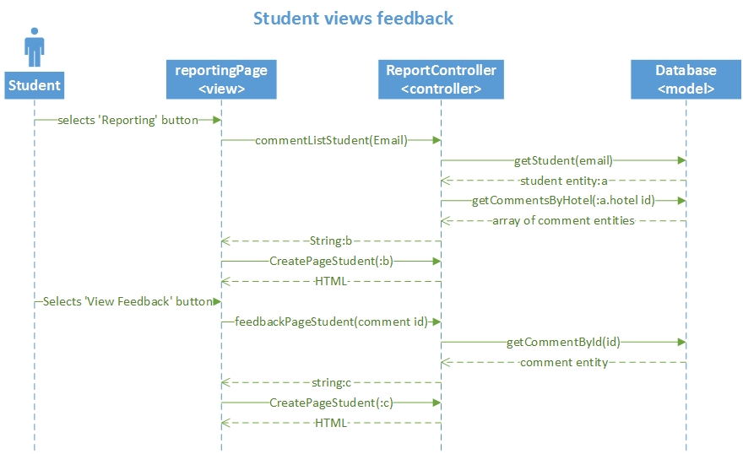
Sequence Diagrams

Slide 8
Live Demonstration
Vi

Slide 9
Software Testing
PHPUnit 4.8.9 by Sebastian Bergmann and contributors. Runtime: PHP 5.5.9-1ubuntu4.11Configuration: /srv/marketsim/www/Tests/phpunit.xml
ReportController
ok - ReportControllerTest::test__constructInvalidPar
ok - ReportControllerTest ::test__construcValidPar
ok - ReportControllerTest ::test_feedbackPage
ok - ReportControllerTest ::test_generateCommentTabl
ok - ReportControllerTest ::test_filterMenu
ok - ReportControllerTest ::test_commentList
ok - ReportControllerTest ::test_chooseGame
ok - ReportControllerTest ::test_selectPeriod
ok - ReportControllerTest ::test_postFeedback
Database
ok - databaseTest::test_getAllComments
ok - databaseTest::test_getCommentById
ok - databaseTest::test_getCommentByGameAndPerio
ok - databaseTest::test_updateFeedback
ok - databaseTest::test_getHotelByGameID
ok - databaseTest::test_getStudentByHotel
ok - databaseTest::test_getMarketShareByHotelAndPe
ok - databaseTest::test_getCommentByHotelAndPerio

Slide 10
Test Case
Test ID: | CreatePage81
Description: | Test ReportController function that returns a template to account page
Test Steps | Step 1 :$obj = new ReportController;
 | Step 2 :$value = "someValue";
 | Step 3: $result = "<form action='' method='post'> <div class='bs-example'>". "<div class='panel panel-default'>". "<div class='panel-body' align='center'>". "<h2>User Accounts Management</h2>"."<a href='http://marketsim-dev.cis.fiu.edu/views/reportingPage.php?button_reports=Reports' class='btn btn-primary'>Reports</a>". "<a href='http://marketsim-dev.cis.fiu.edu/views/reportingPage.php?button_commentRepository=Comment+Repository' class='btn btn-primary'>Comment Repository</a>". "</div>". "<div class='' align='center'>". "<div class='panel-footer clearfix' style='width: 1075px' >". $value. "</div>". "</div>". "</div>". "</div>". "</form>";
 | Step 4:>assertEquals($result, $obj->CreatePage($value));
Tester: | Javier Andrial
Result: | Pass

Slide 11
Strategic Marketing Simulator 1.0
Questions?

